Slide 1
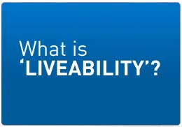
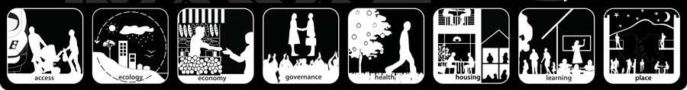
Year 7

Slide 2

'Liveability' - the qualities of a place (city, town, suburb, neighbourhood) that contribute to the quality of life experienced by residents and others.

Slide 3
Brainstorm – what makes a place a good place to live?

Slide 4
What makes a place liveable? We have to consider the factors below:
Environmental
Infrastructure
Cleanliness, dust, pollution, noise, air and water quality,
personal security, traffic safety, community identity and pride.
historic structures, architectural styles, streetscapes
streets, public transport, health, shopping centres, etc
Economic
Value of property
Social
Cultural

Slide 5
The most liveable city in the world??

Slide 6
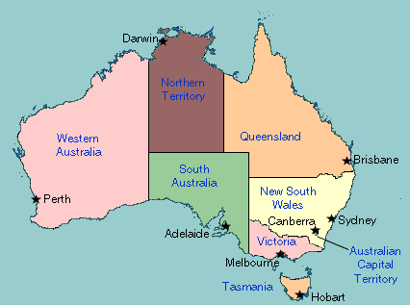
Hint: it is in Australia…

Slide 7
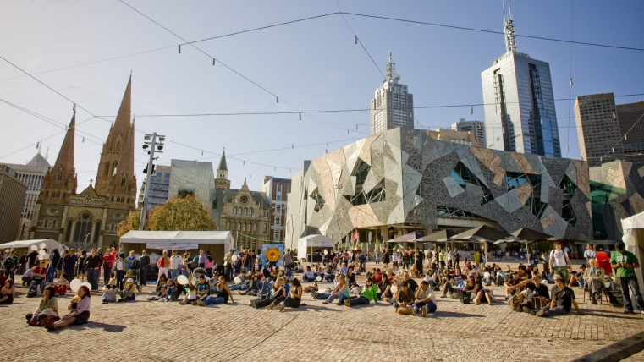
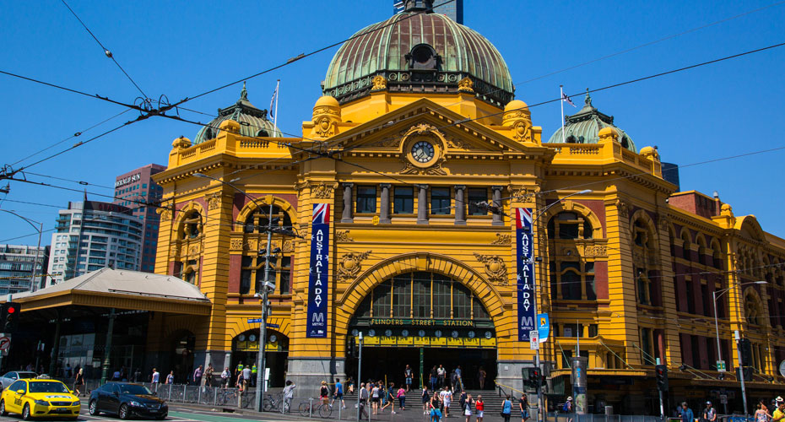
Melbourne
https://www.youtube.com/watch?v=tcrXW1WMvNs

Slide 8
Top 10 cities in the world
https://www.youtube.com/watch?v=V47vDW3bJ-M

Slide 9
Key features of liveable cities
Less overcrowding and less traffic congestion
Most liveable cities are in wealthier countries
Less pollution
Access to clean water
Waste removal and sewerage systems
The people that live there have a ‘good quality’ of life.

Slide 10
Low ranking liveable cities

Slide 11
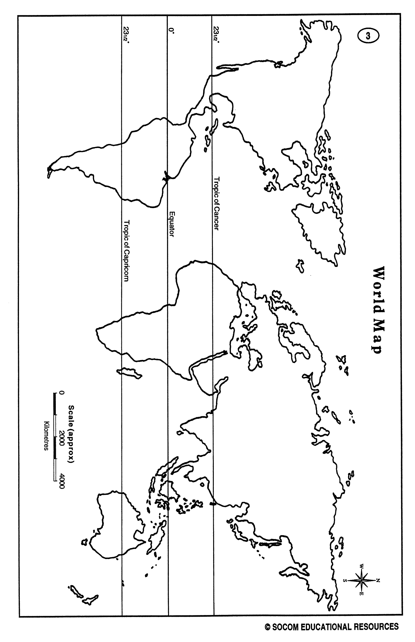
Bangladesh
Legend
Melbourne
Liveable
Unliveable
‘Liveability’

